Slide 1
Introduction to Data Science with Python
WMASDS-04
Week 01: Python Variables and Data Types

Slide 2
Outlines
Variables in Python
Data types in Python
Data structures in Python
Operators in Python
Looping and Branching in Python
Functions in Python
Keywords, Input

Slide 3
Python Variables
Variables are containers for storing data values. A variable is a memory location where you store a value.
The value that you have stored may change in the future according to the specifications.
Variables in python as the name suggests are the values that vary.
A Python Variable is created as soon as a value is assigned to it.
It does not need any additional commands to declare a variable in python.
For a variable, its data type is just the type of data it contains.

Slide 4
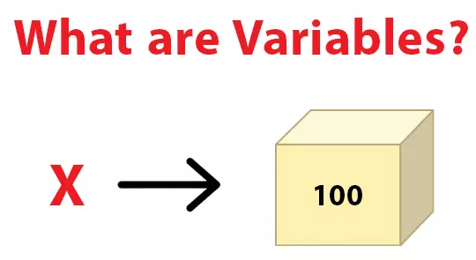
What are variables

Slide 5
Rules for Variables in Python
A variable name must start with a letter or the underscore character
A variable name cannot start with a number
A variable name can only contain alpha-numeric characters and underscores (A-z, 0-9, and _ )
Variable names are case-sensitive (age, Age and AGE are three different variables)
A variable name cannot be any of the Python keywords such as True, False, None, and Def etc.

Slide 6
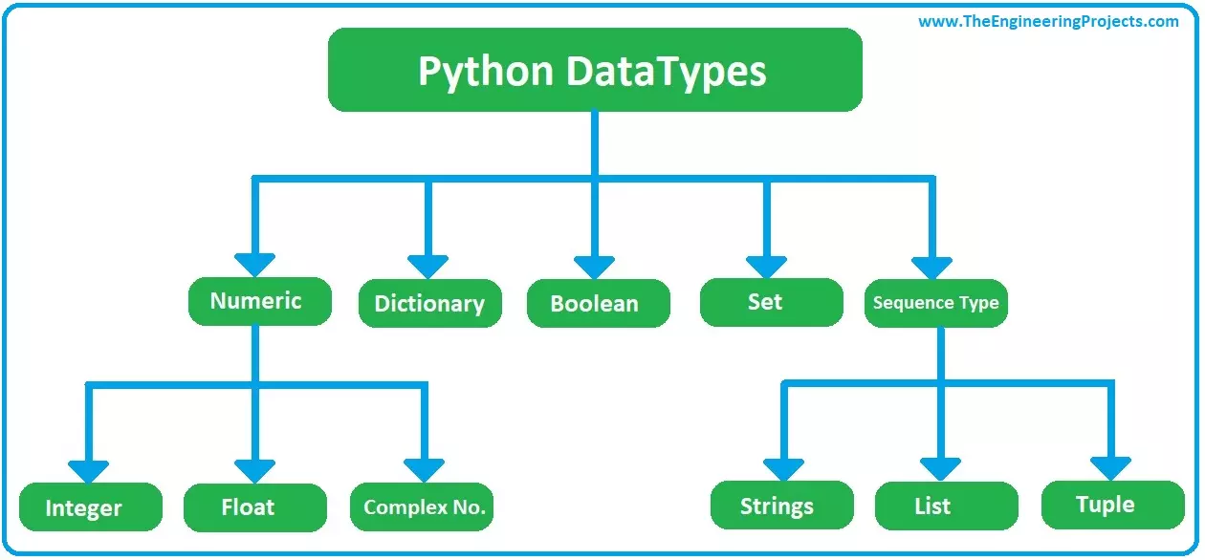
Data Types
.
.

Slide 7
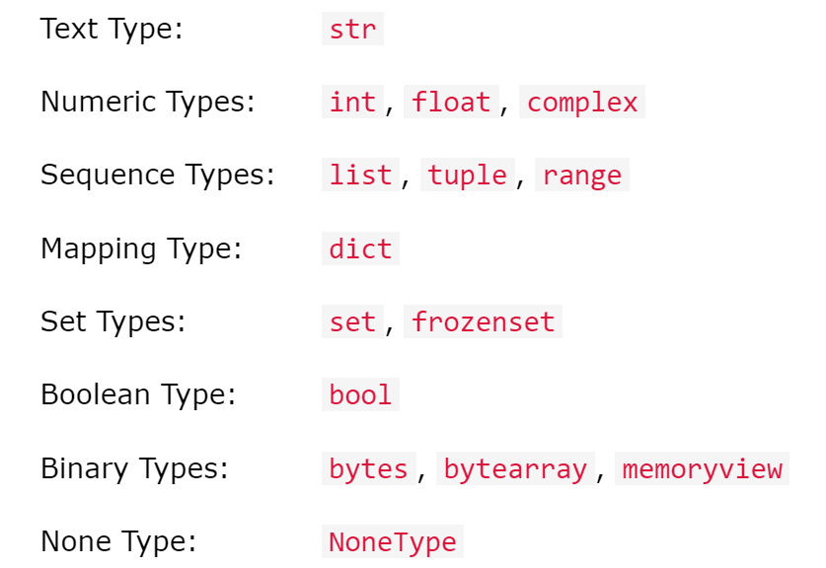
Built-in Data Types
.

Slide 8
Data Types Examples
Example | Data Type
x = "Hello World" | str
x = 20 | int
x = 20.5 | float
x = 1j | complex
x = ["apple", "banana", "cherry"] | list
x = ("apple", "banana", "cherry") | tuple
x = range(6) | range
x = {"name" : "John", "age" : 36} | dict
x = {"apple", "banana", "cherry"} | set
x = frozenset({"apple", "banana", "cherry"}) | frozenset
x = True | bool
x = b"Hello" | bytes
x = bytearray(5) | bytearray
x = memoryview(bytes(5)) | memoryview
x = None | NoneType

Slide 9
Type Casting
The conversion of one data type into the other data type is known as type casting in python or type conversion in python.
Python supports a wide variety of functions or methods like: int(), float(), str(), ord(), hex(), oct(), tuple(), set(), list(), dict(), etc. for the type casting in python.
There are two varieties of typecasting in python namely - Explicit Conversion(Explicit type casting in python), and Implicit Conversion(Implicit type casting in python).
The conversion of one data type into another, done via user intervention or manually as per the requirement, is known as explicit type conversion.
According to the level of data types, one data type is converted into other by the Python interpreter itself (automatically). This is called, implicit type casting in python.

Slide 10
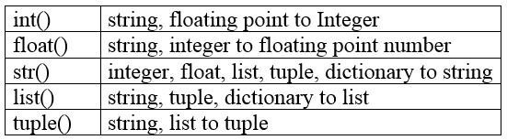
Type Casting Functions in Python

Slide 11
Python Operators
Operators are used to perform operations on variables and values.
Python divides the operators in the following groups:
Arithmetic operators
Assignment operators
Comparison operators
Logical operators
Identity operators
Membership operators
Bitwise operators

Slide 12
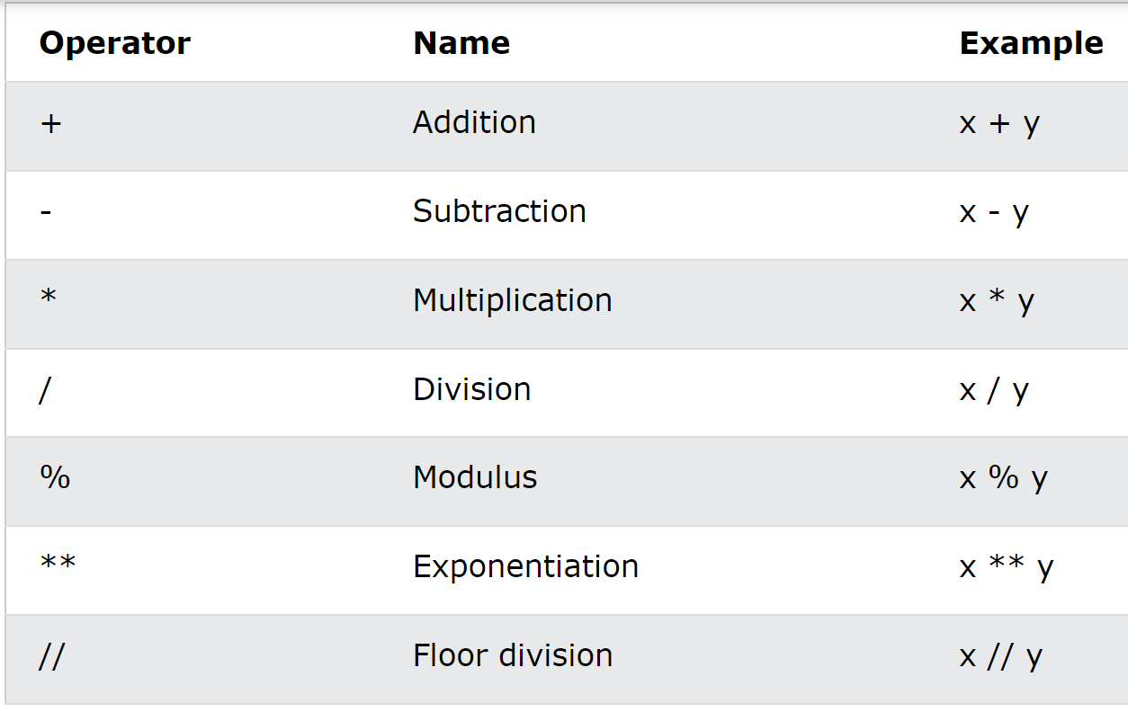
Arithmetic Operators
.

Slide 13
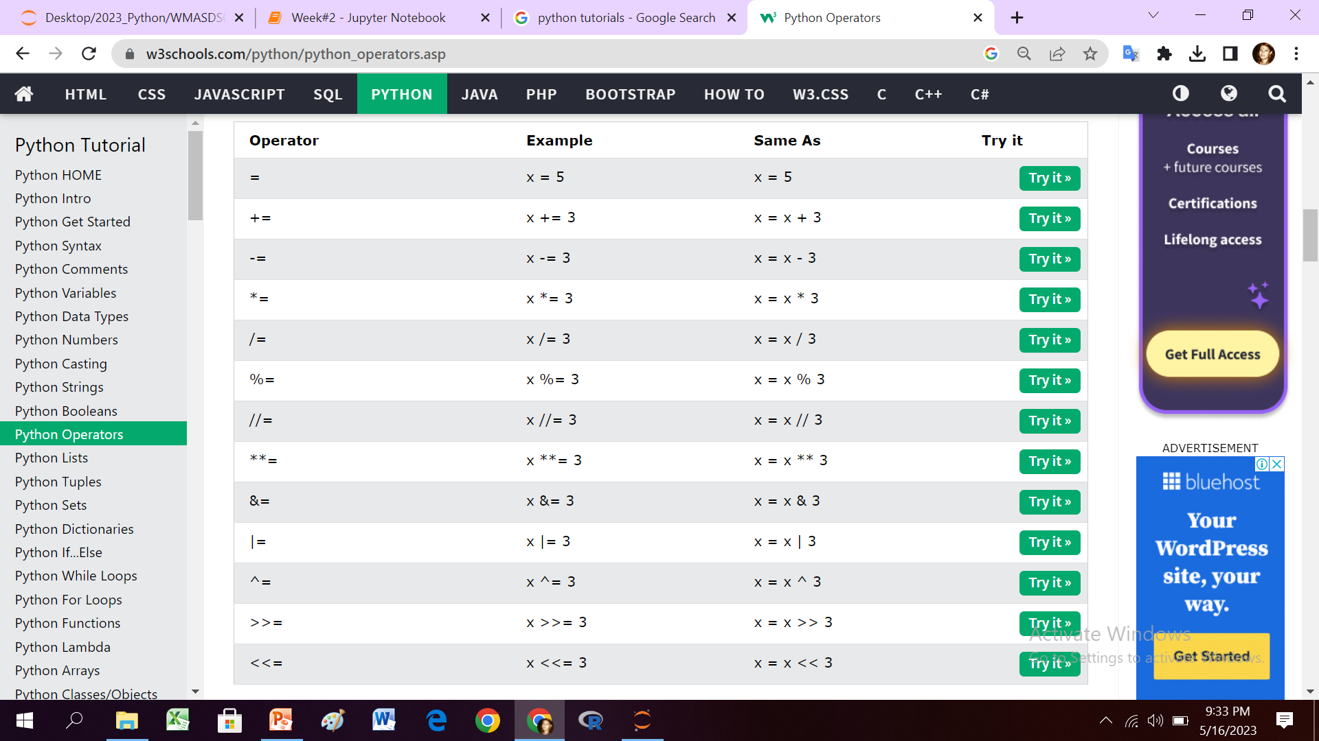
Assignment Operators
.

Slide 14
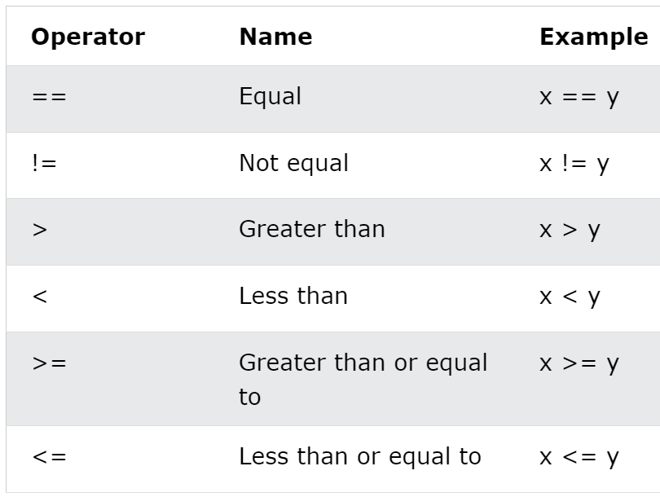
Comparison Operators
.

Slide 15
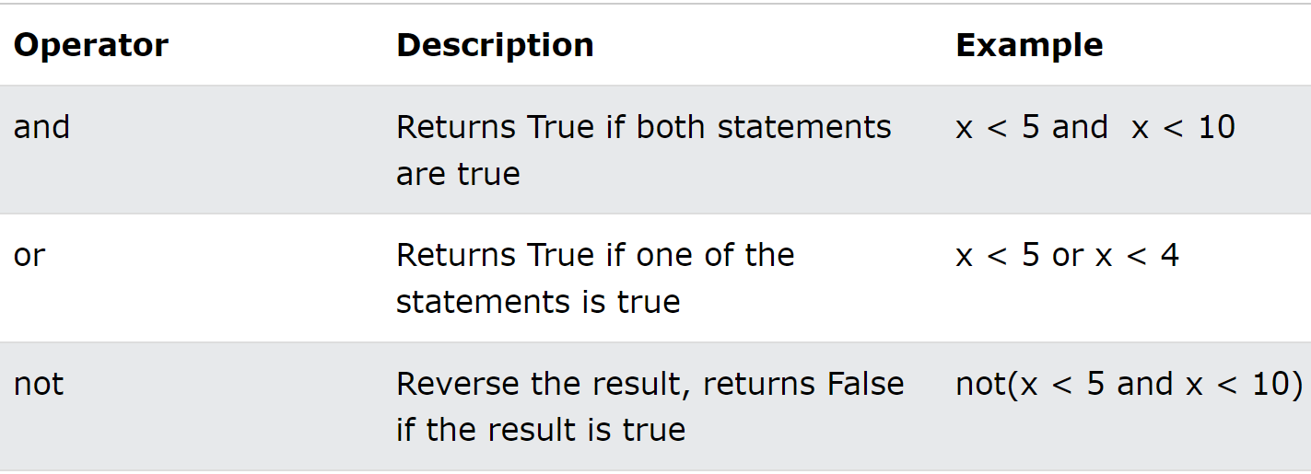
Logical Operators
.

Slide 16
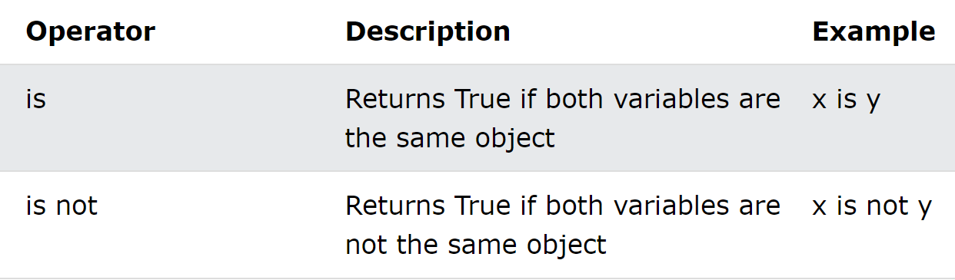
Identity Operators
.

Slide 17
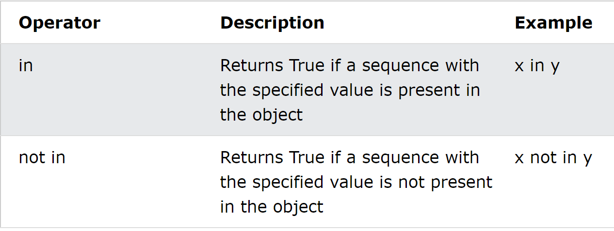
Membership Operators
.

Slide 18
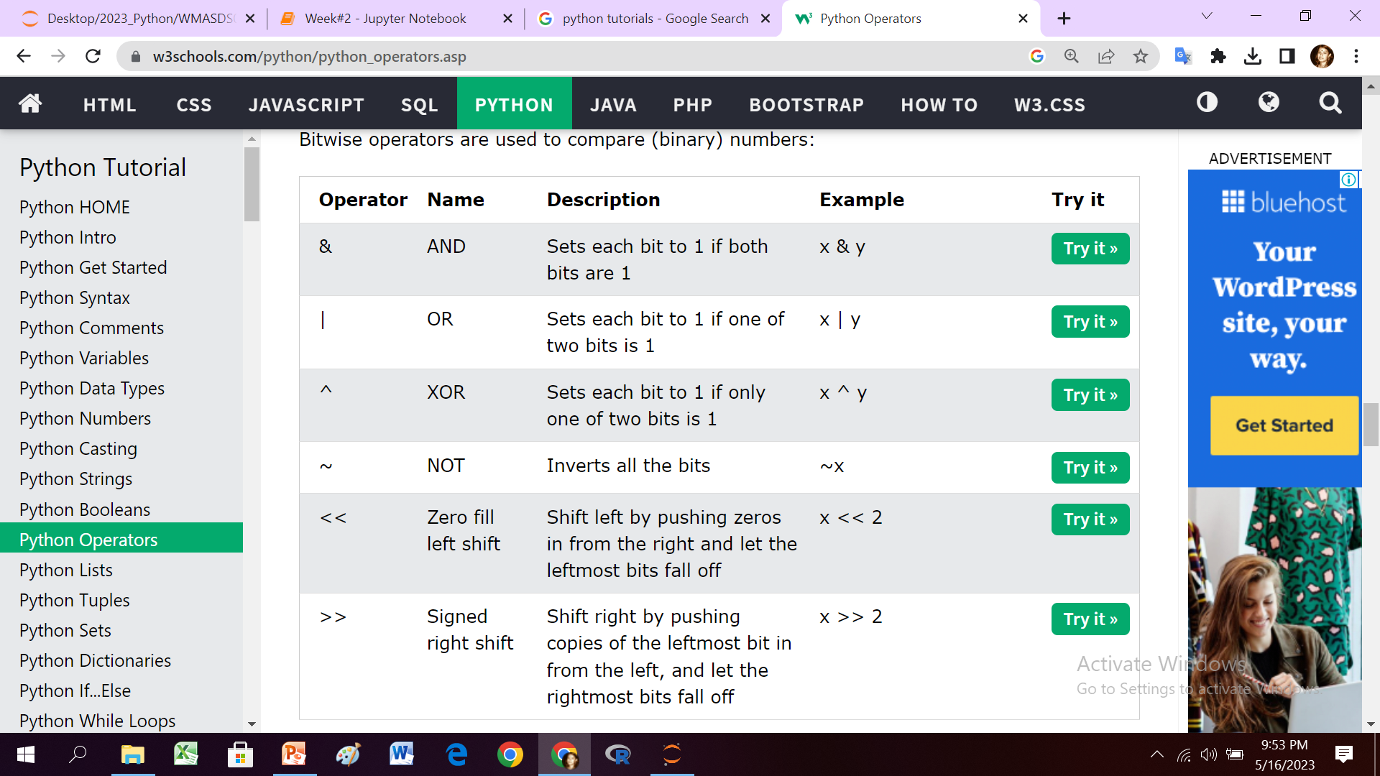
Bitwise Operators
.

Slide 19
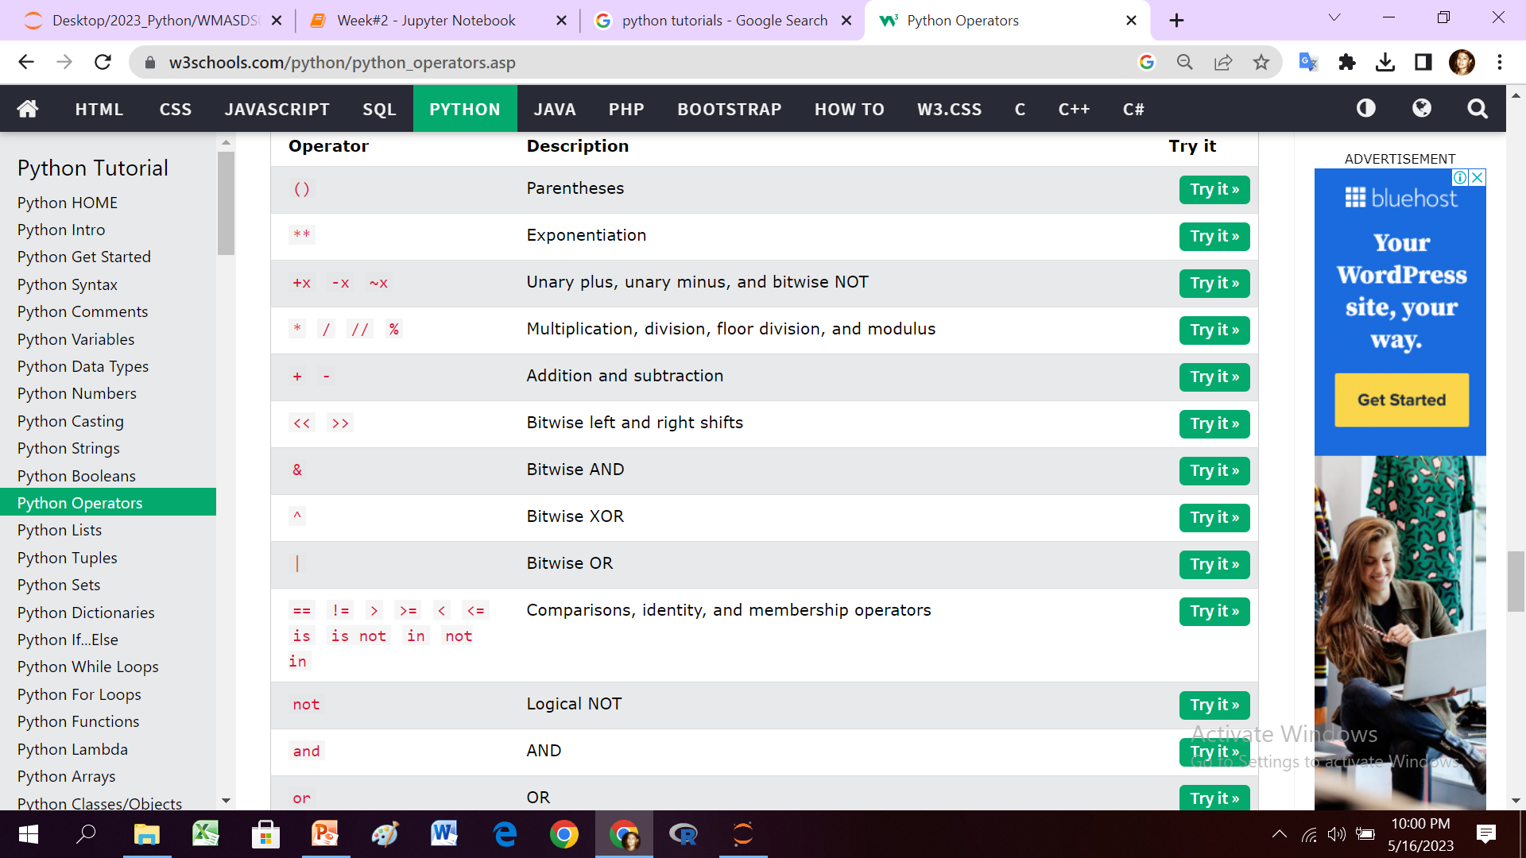
Operator Precedence
.

Slide 20
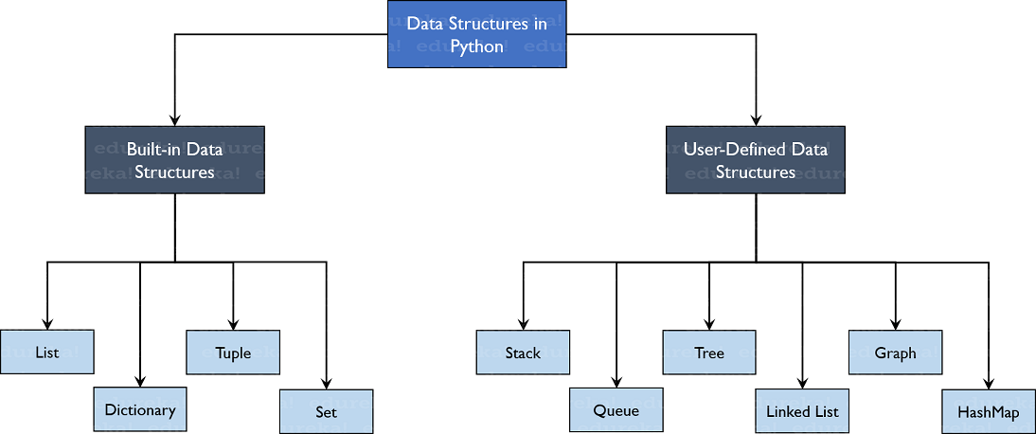
Data Structures in Python
.

Slide 21
Built-in Data Structures in Python
List is a collection which is ordered and changeable. Allows duplicate members.
Tuple is a collection which is ordered and unchangeable. Allows duplicate members.
Set is a collection which is iterable, but unordered, unchangeable*, and unindexed and allows no duplicate members.
Dictionary is a collection which is ordered** and changeable. No duplicate members.
Set items are unchangeable, but you can remove and/or add items whenever you like.
When choosing a collection type, it is useful to understand the properties of that type.
Choosing the right type for a particular data set could mean retention of meaning, and, it could mean an increase in efficiency or security.

Slide 22
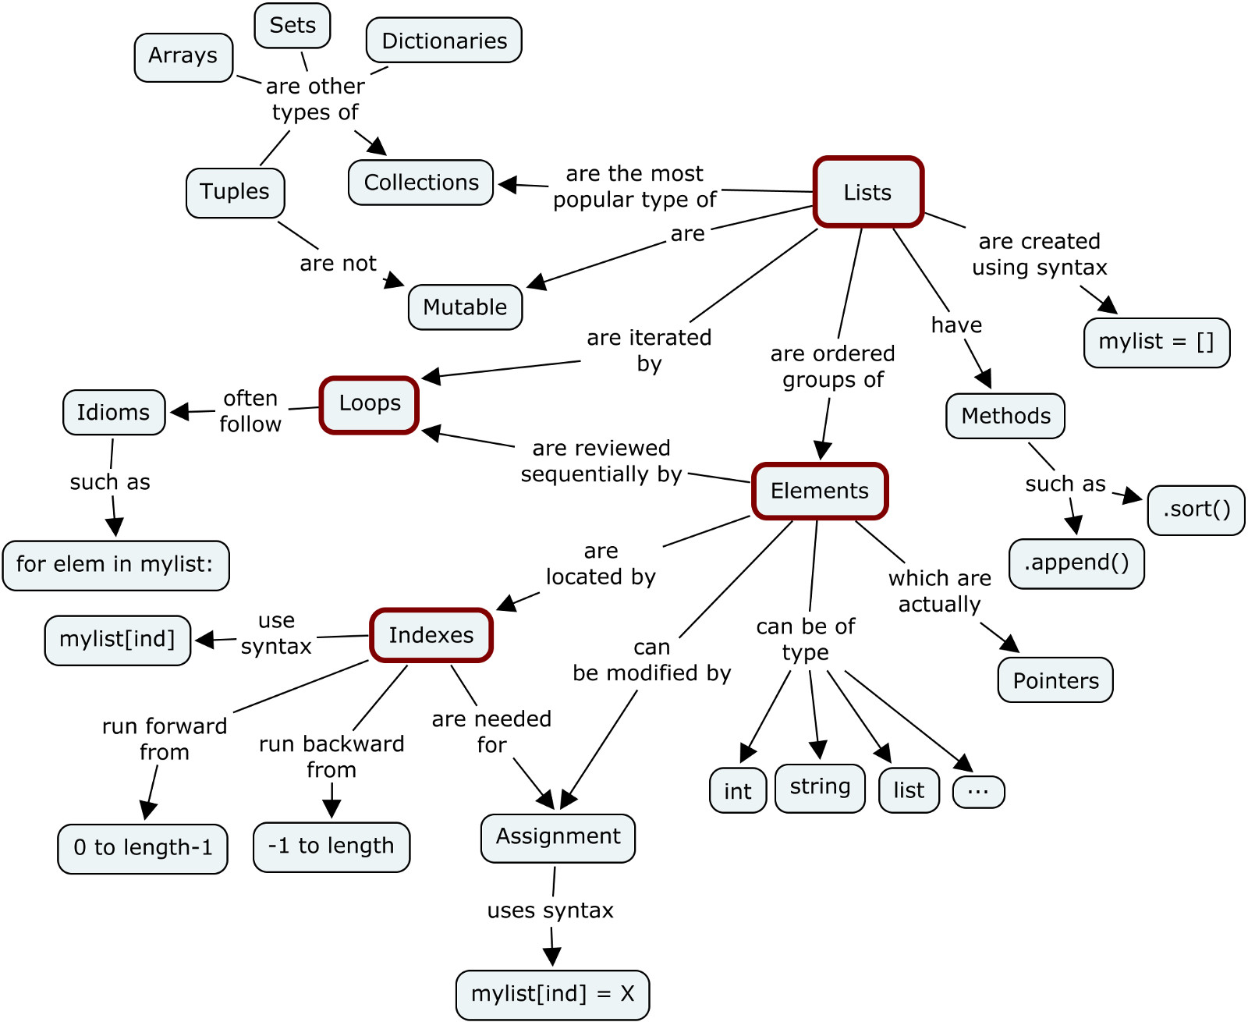
Python Data Structures
.

Slide 23
Built-in Data Structures in Python
Data Structures | List | Tuple | Set | Dictionary
Ordered | Yes | Yes | No | No
Mutable | Yes | No | Yes | Yes
Indexing/ Slicing | Yes | Yes | No | Yes
Duplicate Elements | Yes | Yes | No | No
Constructor | [ ] or list( ) | ( ) or tuple( ) | { } or set( ) | { } or dict( )
Example | [‘a’, 1, 2.5, True, 1] | (‘a’, 1, 2.5, True, 1) | {‘a’, 1, 2.5, True} | {‘a’: 1, ‘b’:2}

Slide 24
List
Lists are used to store multiple items in a single variable.
Lists are created using square brackets.
List items are indexed, the first item has index [0], the second item has index [1] etc.
The items have a defined order, and that order will not change.
The new items will be placed at the end of the list.
We can change, add, and remove items in a list after it has been created.
To determine how many items a list has, use the len() function:
A list can contain different data types: integer, float, string, boolean
The list() can be used to create a new list.
["abc", 34, True, 40, 40, "male"]

Slide 25
Tuple
Python Tuples are like a list. It can hold a sequence of items. The difference is that it is immutable.
To declare a Python tuple, you must type a list of items separated by commas, inside parentheses. Then assign it to a variable.
You should use a tuple when you don’t want to change just an item in future.
Tuple packing refers to assigning multiple values into a tuple. Tuple unpacking refers to assigning a tuple into multiple variables.

Slide 26
Set
A Set in Python programming is an unordered collection data type that is iterable, mutable and has no duplicate elements.

Slide 27
Dictionary
a Python dictionary holds key-value pairs.
To create a Python Dictionary separate keys from values with a colon(:), and a pair from another by a comma(,). Finally, put it all in curly braces.

Slide 28
Looping and Branching in Python
If-else ,
while Loop,
for Loop,

Slide 29
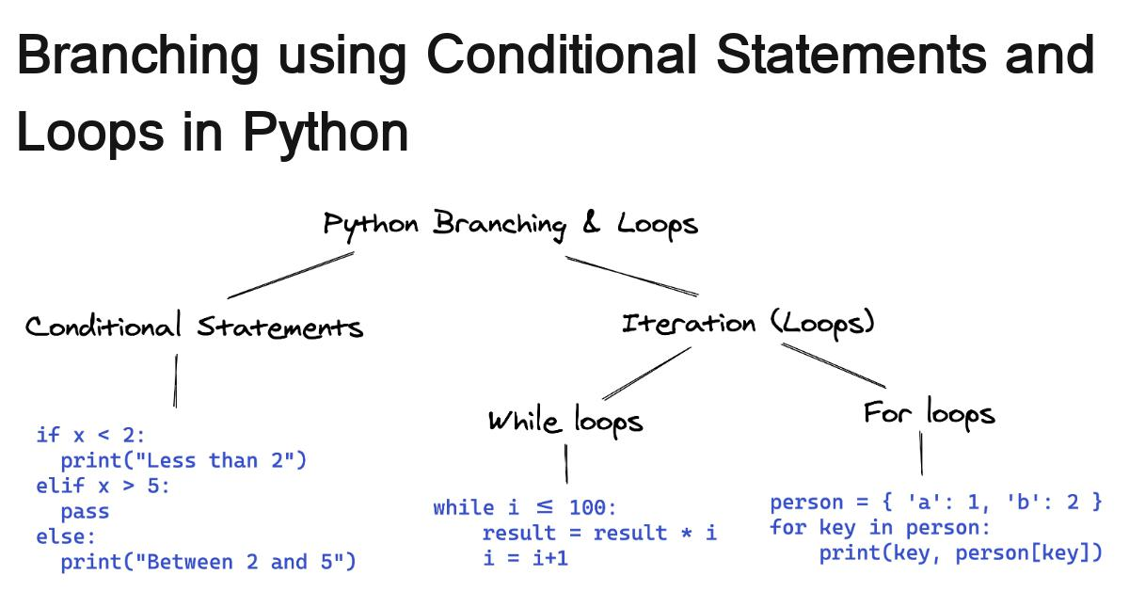
Looping and Branching in Python
.

Slide 30
An Infinite Loop (while)
Be careful while using a while loop. Because if you forget to increment the counter variable in python, or write flawed logic, the condition may never become false.
In such a case, the loop will run infinitely, and the conditions after the loop will starve. To stop execution, press Ctrl+C.

Slide 31
Python Functions
A function is a block of code that has a name and only runs when it is called.
Functions can take arguments/parameters and return values.
Function types in python
Built-in
User-defined
Anonymous or lambda
Recursive
Python built-in functions example:
print(), type(). Len()

Slide 32
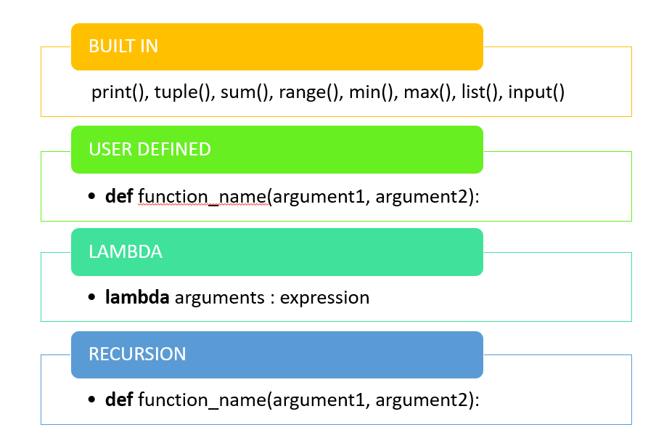
Types of Python Functions
.

Slide 33
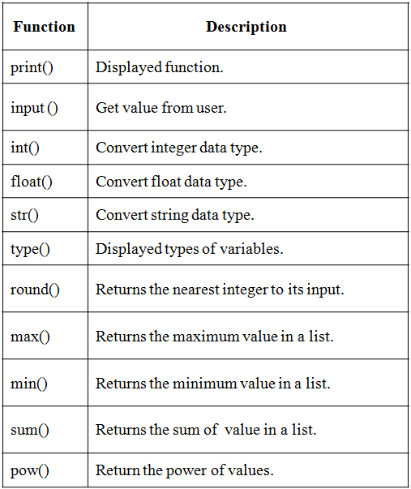
Some of Python Built-in Functions

Slide 34
User-defined Function
To define a function, use the def keyword.
give the function a name and it can take some parameters(or arguments)
Information can be passed into functions as arguments
Arguments are specified after the function name, inside the parentheses.
Several arguments are separated with a comma.
Then specify a block of code that will execute when the function is called.
you need to indent this code block otherwise it won’t work.

Slide 35
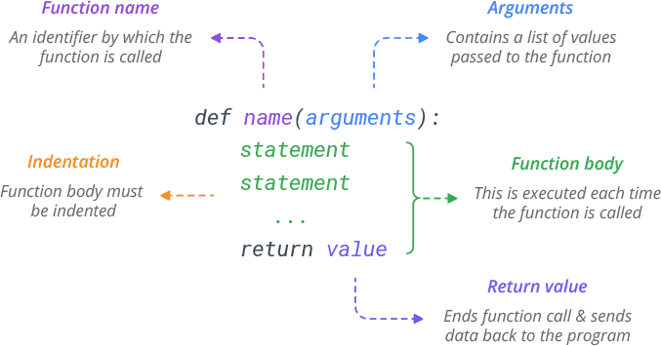
How to Define a Function
.

Slide 36
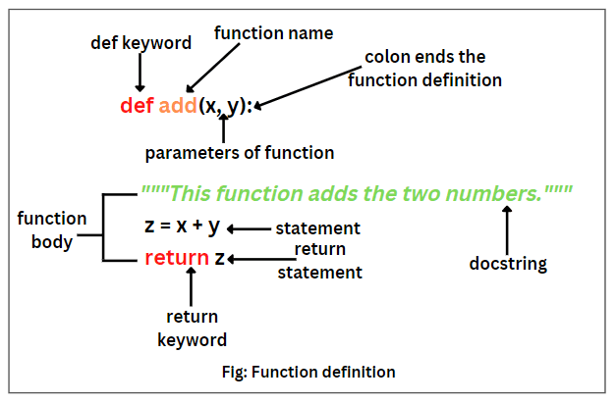
Example: User-defined Function
.

Slide 37
Arguments/Parameters of Function
An argument is the value that is sent to the function when it is called.
Information can be passed into functions as arguments.
Arguments are specified after the function name, inside the parentheses. You can add as many arguments as you want, just separate them with a comma.
A function must be called with the correct number of arguments.

Slide 38
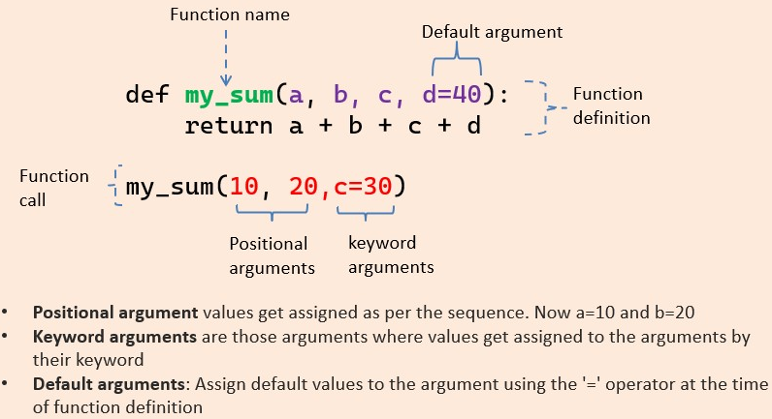
Arguments in Python Functions
.

Slide 39
Argument order
Argument order in function declarations
Regular arguments
*args
**kwargs

Slide 40
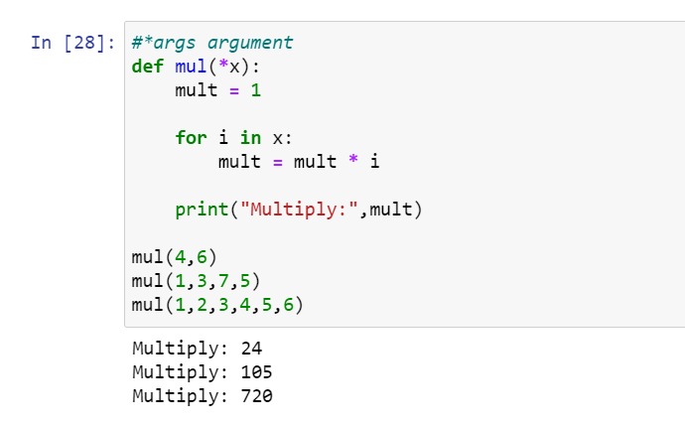
Arbitrary Arguments(*args)
allows a function to accept variable number of positional arguments
arguments that are non-keyword arguments, variable-length argument list.
the function will receive a tuple of arguments.
.

Slide 41
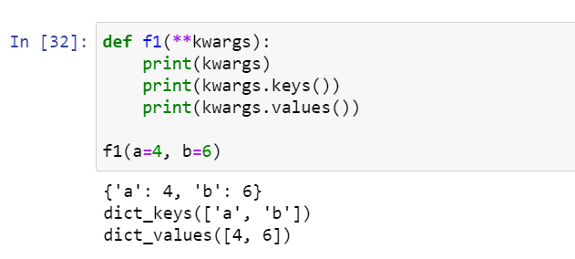
Arbitrary Keyword Arguments:(**kwargs)
it accepts keyword arguments such as those from a dictionary (i.e. a dictionary of arguments).

Slide 42
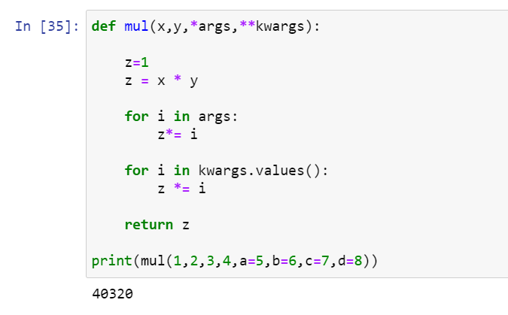
Using both *args and **kwargs
.

Slide 43
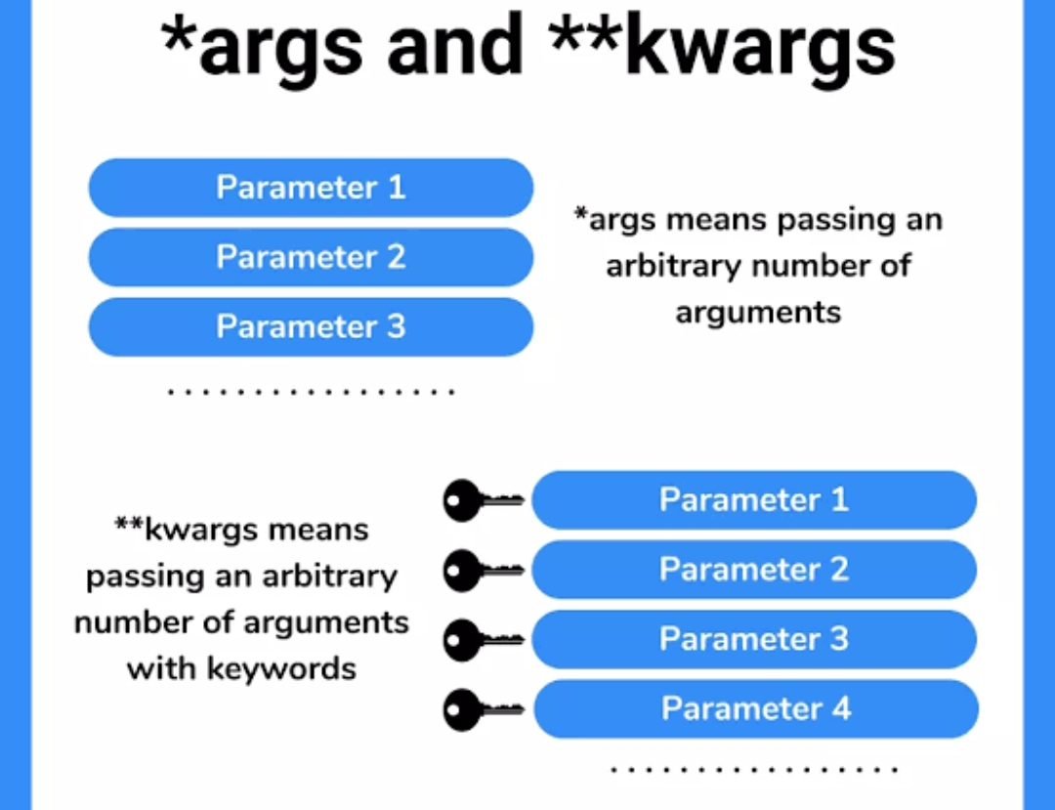
*arg vs **kwargs

Slide 44
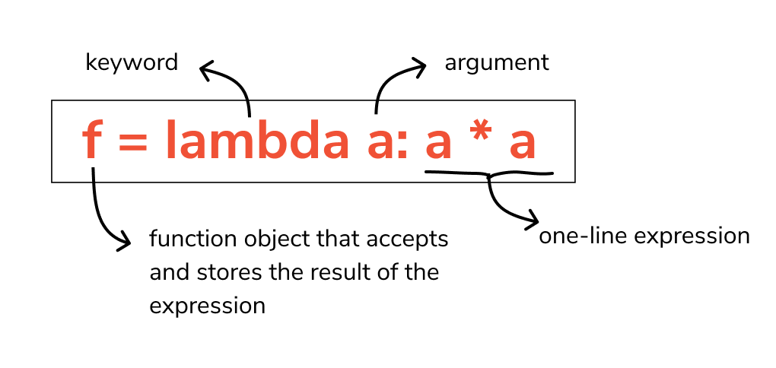
Lambda Function
.

Slide 45
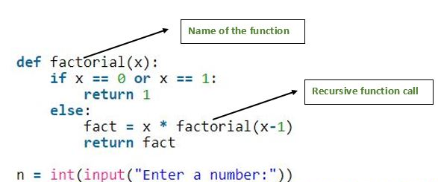
Recursive Function
.

Slide 46
Methods vs Functions
A function doesn't need any object and is independent, while the method is a function, which is linked with any object.
We can directly call the function with its name, while the method is called by the object's name.
Function is used to pass or return the data, while the method operates the data in a class.

Slide 47
Python Functions vs Methods
Functions in Python | Methods in Python
Functions are outside a class | Methods are created inside a class
Functions are not linked to anything | Methods are linked with the classes they are created in
Functions can be executed just by calling with its name | To execute methods, we need to use either an object name or class name and a dot operator.
Functions can have zero parameters. | Methods should have a default parameter either self or cls to get the object’s or class’s address.
Functions can not access or modify class attributes | Methods can access and modify class attributes
Functions are independent of classes | Methods are dependent on classes

Slide 48
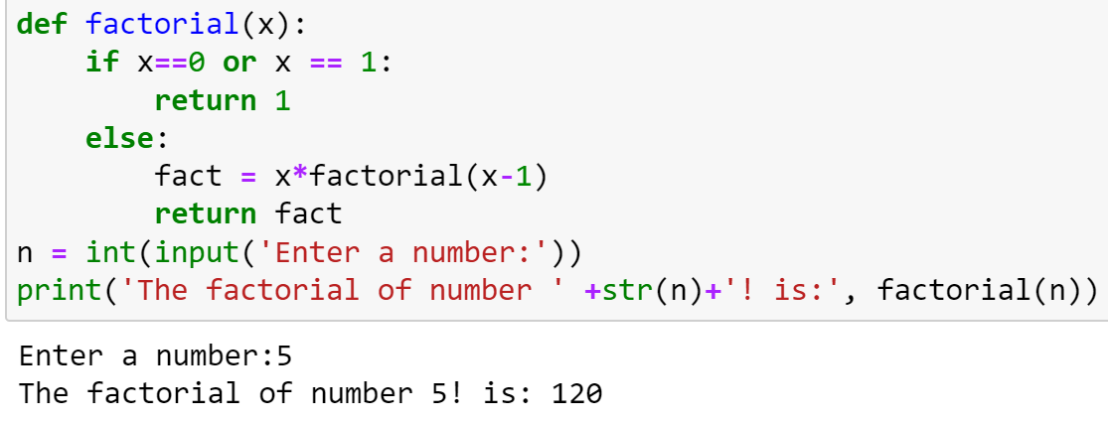
Input Function in Python
Python input() function is used to get input from the user.
After reading data, it converts it into a string.
It returns the user input in form of a string.
.

Slide 49
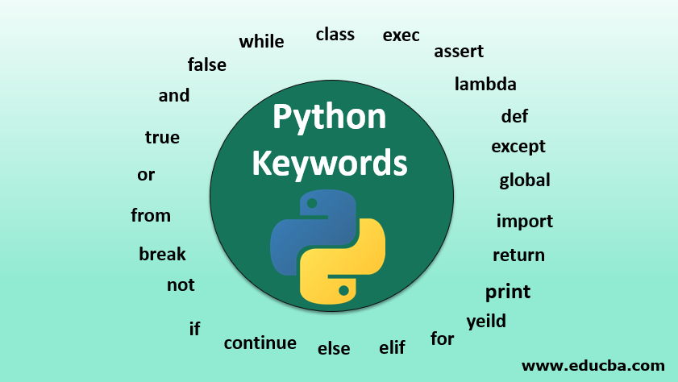
Keywords in Python
.

Slide 50
Different Types of Keywords in Python
Value Keywords: True, False, None
Operator Keywords: and, or, not, in, is
Control Flow Keywords: if, elif, else
Iteration Keywords: for, while, break, continue, else
Structure Keywords: def, class, with, as, pass, lambda
Returning Keywords: return, yield
Import Keywords: import, from, as
Exception-Handling Keywords: try, except, raise, finally, else, assert
Asynchronous Programming Keywords: async, await
Variable Handling Keywords: del, global, nonlocal

Slide 51
Thank you

